Slide 1


Predict ratings of Sephora website products
Ouykhy Quach
FEB, 11th | PARIS
DAFT NOV21

Slide 2
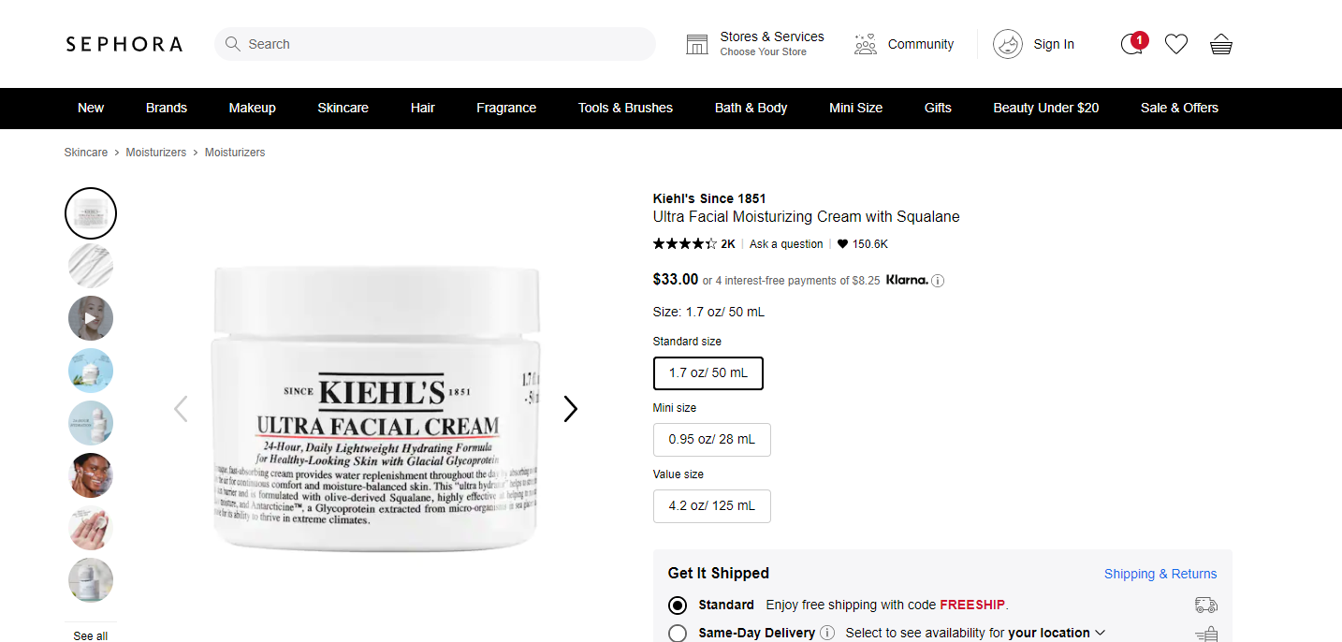
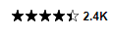
Business case
Customer ratings can impact the customer buying decision
Predicting rating of products and issue recommendations on crucial information will improve the ratings

Slide 3

Plan
Explore and analyse the dataset to draw some initial insights,
cleaning and preparation
Leverage supervised ML to predict the ratings based on the historical data
Leverage unsupervised ML clustering to group the products based on the available features

Slide 4



Data description
Dataset scrapped from Sephora website from April 2020
available on Kaggle
Shape: 21 columns and > 9000 rows
Mix of categorical (14)
and numeric data (7)
Products info include
Brand
Category
details description
how to use guidance
Ingredients
Rating
number of reviews
number of love
price

Slide 5




Exploratory data analysis
Target
Influencing
the rating
Not influencing
the rating
Rating column ranging
from 0 to 5
Number of reviews
Number of love
Ingredients listed
Price
Size
Specific marketing /Exclusive / online
Description of the product (length of ‘details’)
Instructions (length of ‘how to use’)
Tableau dashboard

Slide 6




Data cleaning / preparation
Dropped 9 columns containing either unique values, redundant or inappropriate info
Encoded the categorical columns values: ‘Category’, ‘Brand’
Transformed the object columns values (‘details’ and ‘how to use’) to count the length of strings
‘ingredients’ column was encoded to show known or unknown
The ‘rating’ imbalanced target was transformed with oversample and undersample methods
Rating | Distribution | After balancing
0.0 | 398 | 3527
1.0 | 23 | 3527
1.5 | 9 | 3527
2.0 | 39 | 3527
2.5 | 88 | 3527
3.0 | 308 | 3527
3.5 | 1051 | 3527
4.0 | 2853 | 3527
4.5 | 3527 | 3527
5.0 | 872 | 3527
 | > 9 000 | > 30 000

Slide 7
Models and results
Supervised ML for prediction
 | accuracy score
Logistic regression | 38 %
KNN Classifier (n=5) | 73 %
Random Forest Classifier (estimators 200) | 82 %
Extra Trees Classifier (estim 200,500,1000) | 81 %
TPOT Random Forest Classifier XGBClassifier | 79 % 79 %
Unsupervised ML for clustering
 | Silhouette Coefficient
Kmeans for 3 clusters* | 0.91
Kmeans for 4 clusters | 0.87
Agglomerative Clustering for 3 clusters | 0.88
Agglomerative Clustering for 4 clusters | 0.86
DBSCAN | - 0.45
Elbow method for optimal value of k in Kmeans: 3

Slide 8
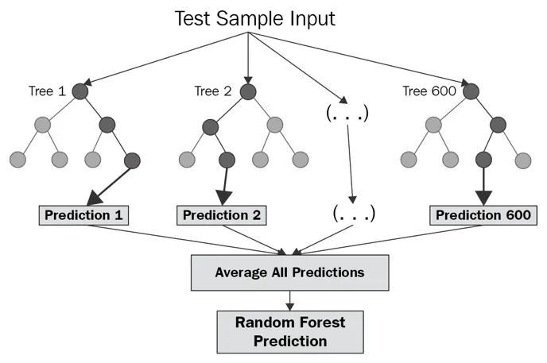
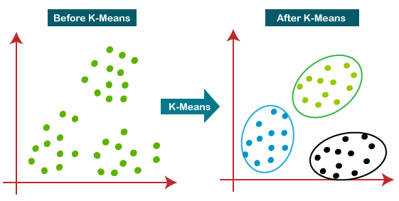
Models comparison
Random Forest Classifier contains several decision trees (200) on various subsets of the dataset. It takes the average to improve the predictive accuracy
KMeans algorithm aims to find groups in the data. It works iteratively to assign each data point to one of the groups based on the features that are provided. Data points are clustered based on feature similarity.

Slide 9





Main results
In the Exploratory data analysis we observed
the number of review has an impact on the rating (average 300/400)
similarly the number of love is high for best ratings (20k)
Products with good rating show a high proportion of ingredients listed
The Random Forest Classifier model is able to predict the rating with an accuracy score of 82%
The Kmeans model clustered the products in 3 groups; reducing the number of rating from 5 to 3 could simplify the scoring process.

Slide 10
Questions ?
Predict ratings of Sephora website products
Ouykhy Quach

